Slide 1
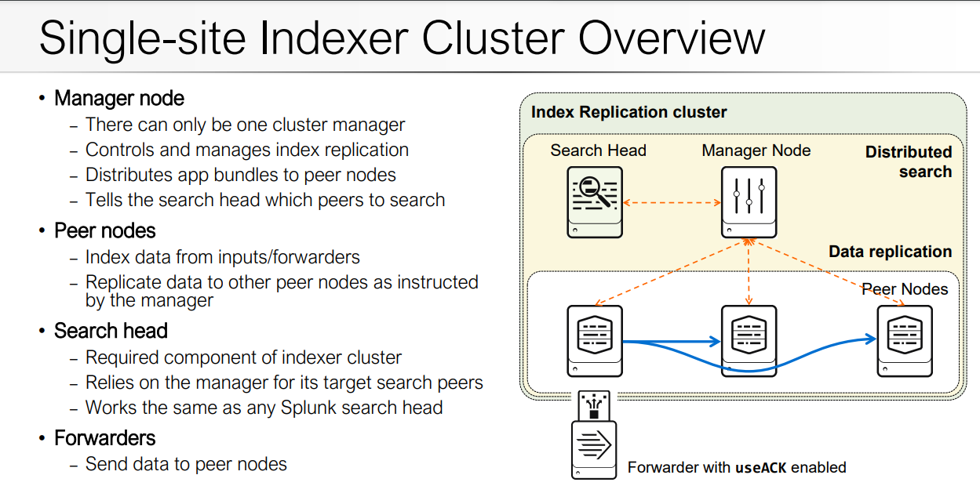

Slide 2
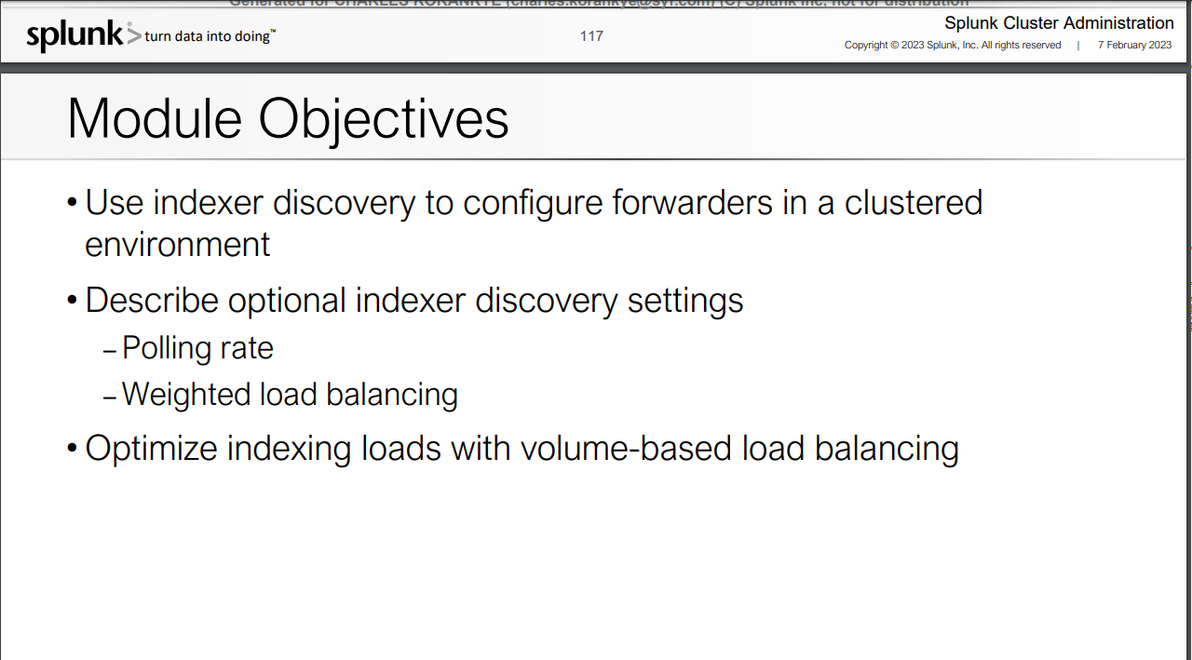
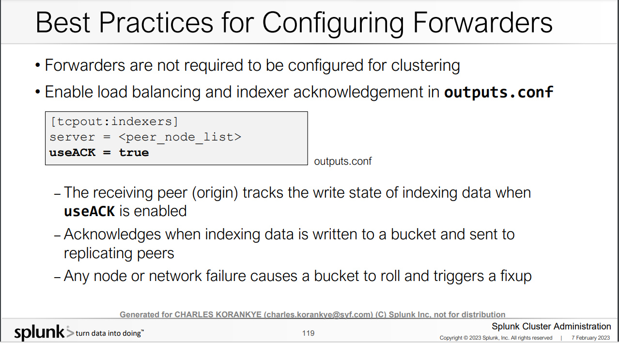

Slide 4
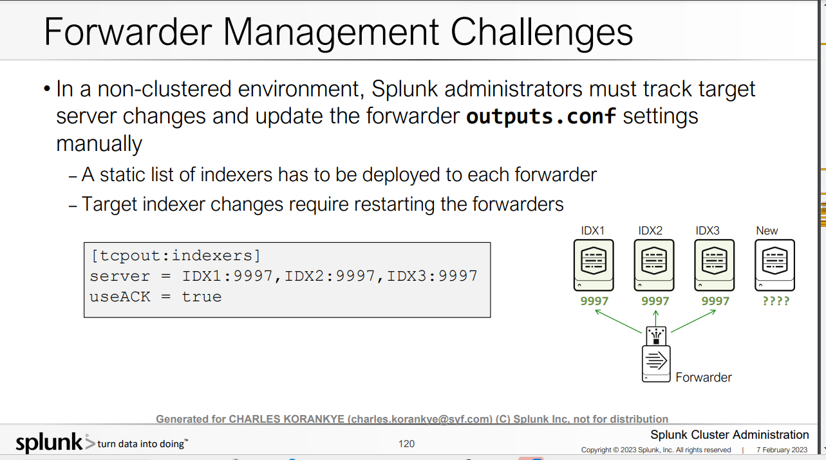

Slide 5
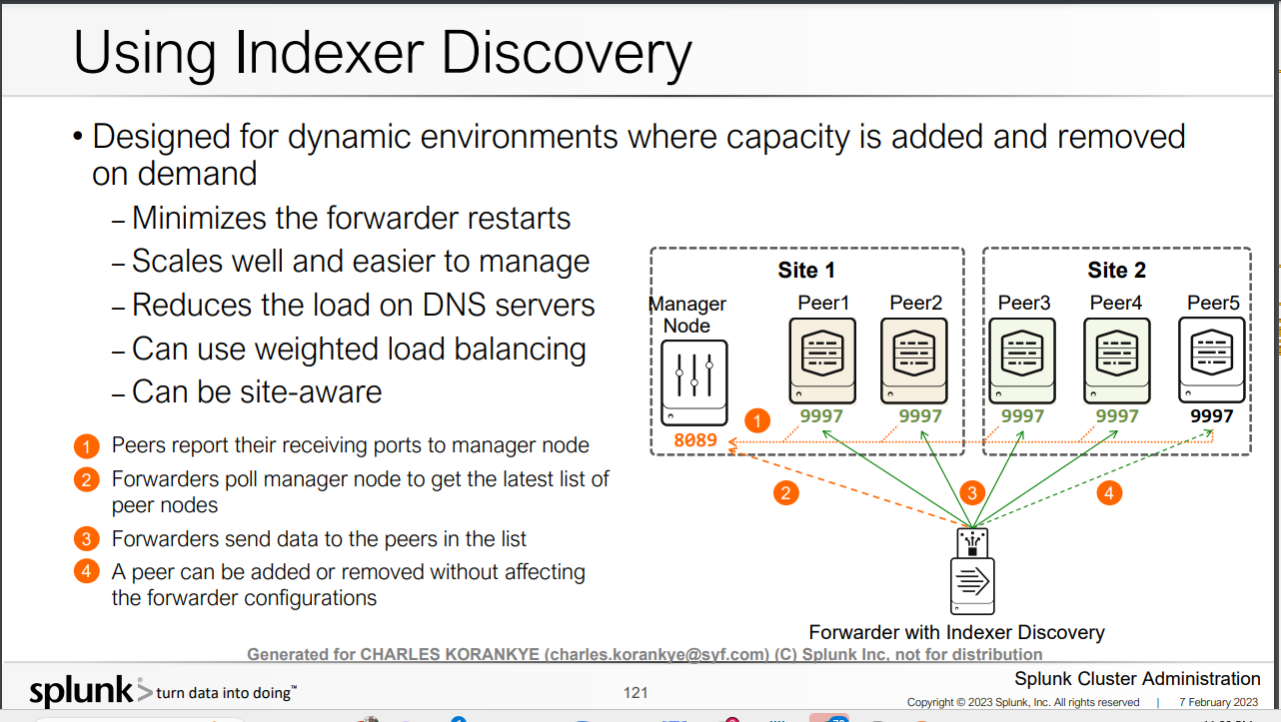

Slide 6
Configure the manager node in server.conf Enable the manager node The following example shows the basic settings that you configure when enabling a manager node. [clustering] mode = manager replication_factor = 2 search_factor = 2 pass4SymmKey = whatever cluster_label = cluster1 OR you can run the below command at cli on all your indexers
Enable the manager node
The following example shows the basic settings that you typically configure when enabling a manager node. The configuration attributes correspond to fields on the Enable clustering page of Splunk Web.
./splunk edit cluster-config -mode manager -replication_factor 4 -search_factor 3 -secret your_key -cluster_label cluster1 splunk restart
The -secret flag modifies the pass4SymmKey setting in the [clustering] stanza of server.conf.
When the manager node starts up for the first time, it will block indexing on the peers until you enable and restart the full replication factor number of peers. Do not restart the manager while it is waiting for the peers to join the cluster. If you do, you will need to restart the peers a second time.

Slide 7
Configure peer nodes with server.conf Prerequisites Before reading this topic, see Configure the indexer cluster with server.conf Enable a peer node The following example shows the basic settings that you must configure when enabling a peer node on all your indexrs. [replication_port://9887] [clustering] manager_uri = https://10.152.31.202:8089 mode = peer pass4SymmKey = whatever OR you can run the below command at cli on all your indexers To enable an instance as a peer node, set mode to "peer". You also need to specify manager_uri, which specifies the cluster's manager node, and replication_port. In addition, you must specify the cluster-wide security key (secret): >>./splunk edit cluster-config -mode peer -manager_uri https://10.160.31.200:8089 -replication_port 9887 -secret your_key >>splunk restart

Slide 8
OR you can configure the indexer clustering through splunkweb https://www.linkedin.com/pulse/how-create-indexer-cluster-splunk-under-10-mins-splunk-mania/

Slide 9
OR you can configure the indexer clustering through splunkweb https://www.linkedin.com/pulse/how-create-indexer-cluster-splunk-under-10-mins-splunk-mania/

Slide 10
OR you can configure the indexer clustering through splunkweb https://www.linkedin.com/pulse/how-create-indexer-cluster-splunk-under-10-mins-splunk-mania/

Slide 11
OR you can configure the indexer clustering through splunkweb https://www.linkedin.com/pulse/how-create-indexer-cluster-splunk-under-10-mins-splunk-mania/

Slide 12
OR you can configure the indexer clustering through splunkweb https://www.linkedin.com/pulse/how-create-indexer-cluster-splunk-under-10-mins-splunk-mania/

Slide 13
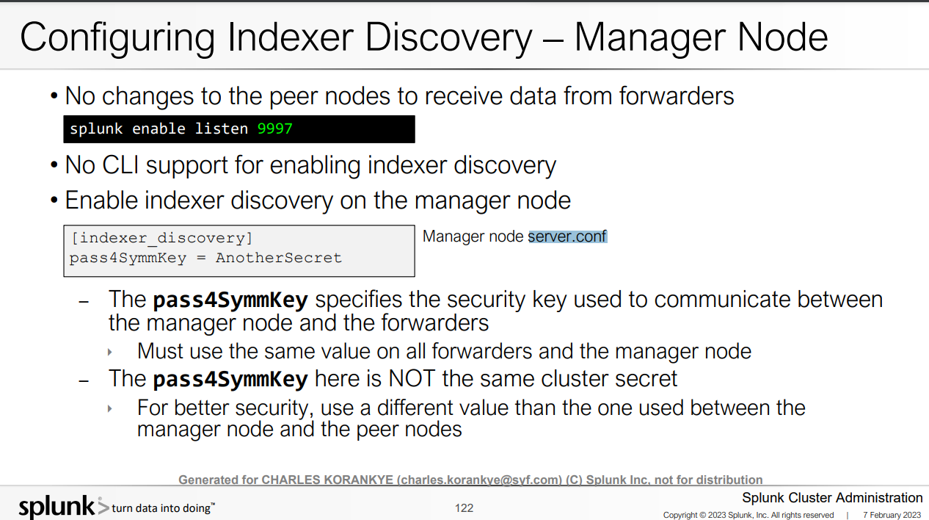
OR you can configure the indexer clustering through splunkweb https://www.linkedin.com/pulse/how-create-indexer-cluster-splunk-under-10-mins-splunk-mania/

Slide 14
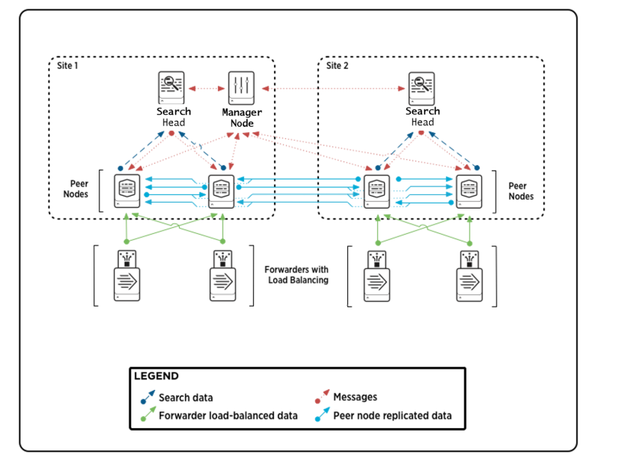

Slide 15
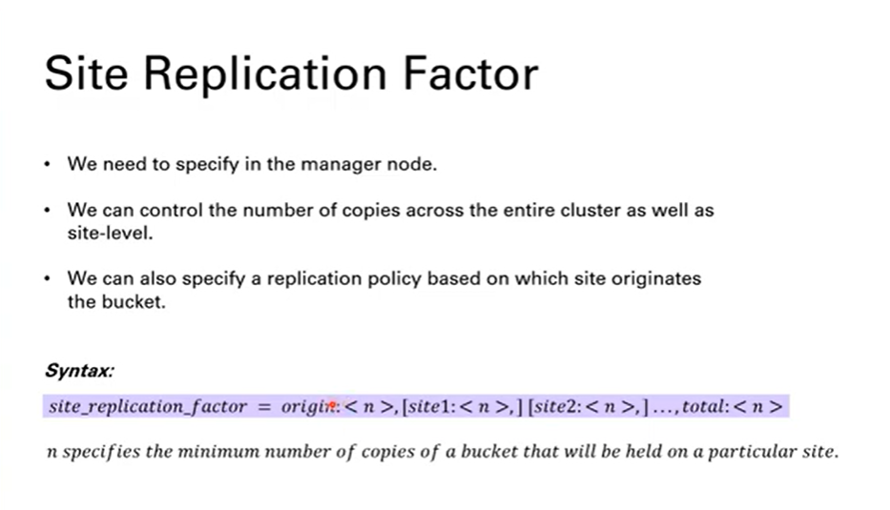

Slide 16
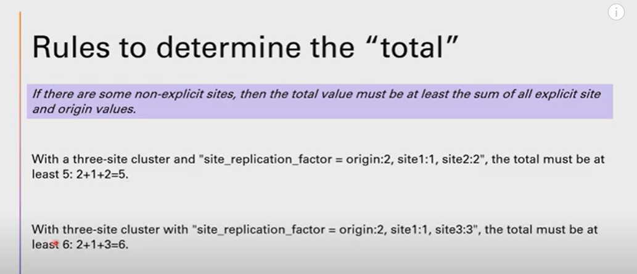

Slide 17
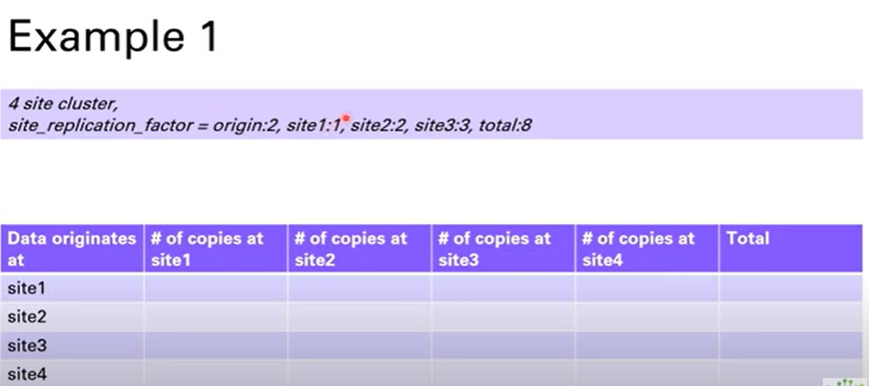

Slide 18
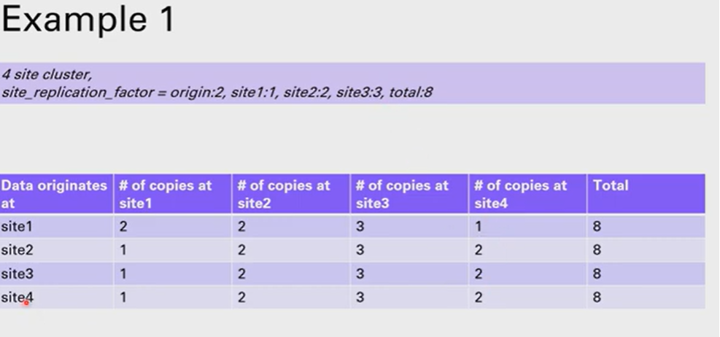

Slide 19
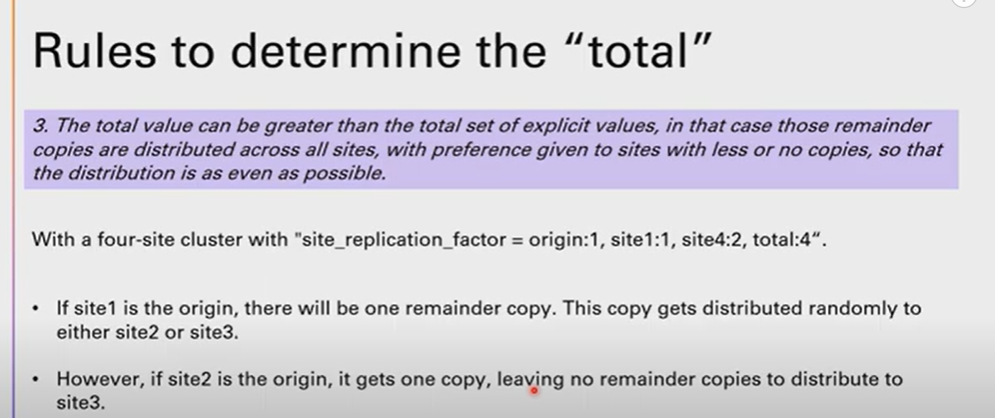
Pears must be available to take the copies

Slide 20
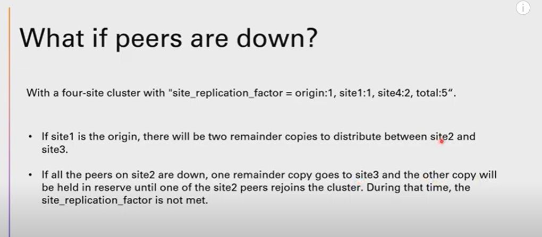

Slide 21
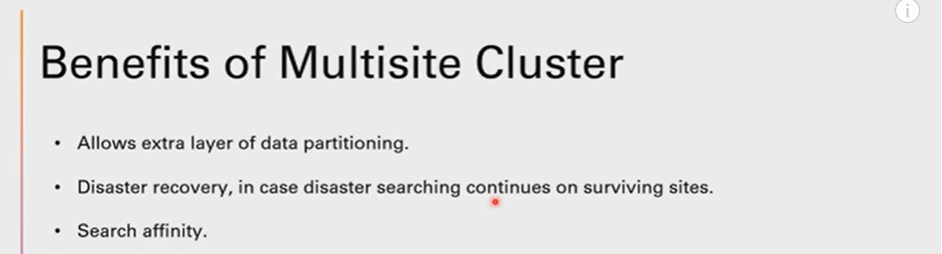

Slide 22
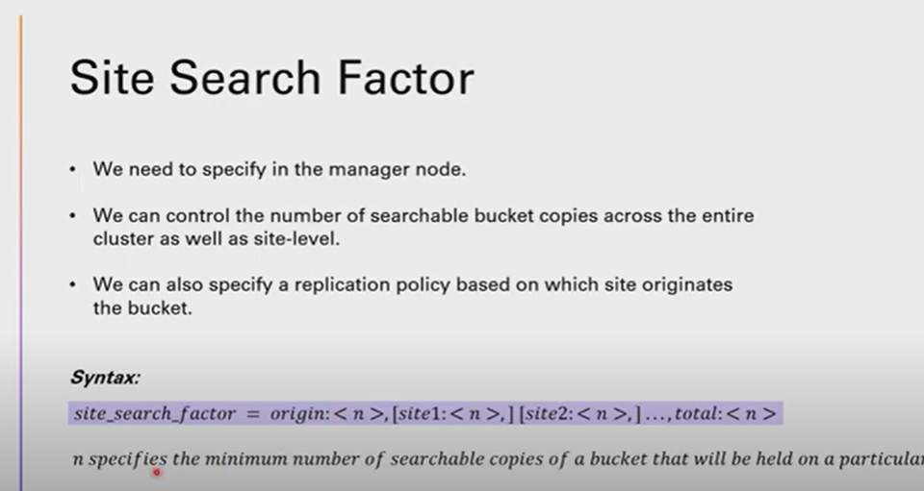

Slide 23
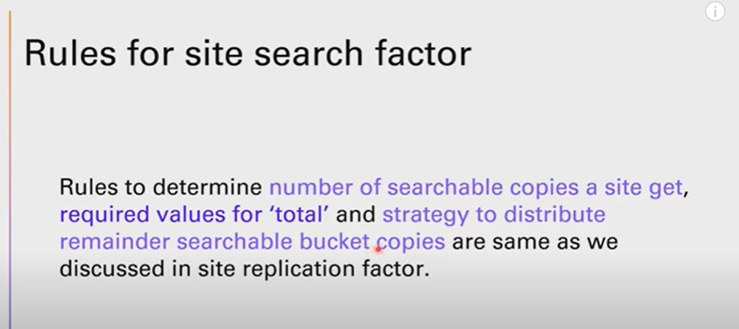

Slide 24
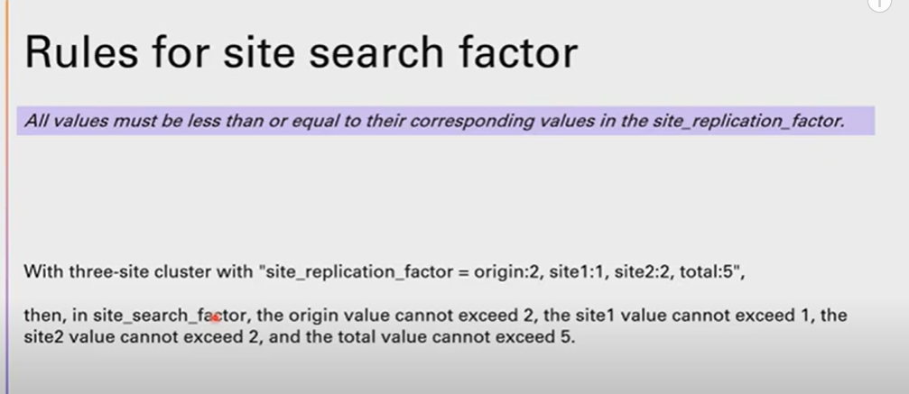

Slide 25
